Slide 1
Transaction Cost Analysis
TCA is not new but is increasingly becoming the focal point of traders
TCA is about modelling transaction costs
Purpose is to
i) reduce transaction costs and
ii) prove efficient market execution
Relatively straightforward in centralized markets
Difficult for OTC markets such as for FX

Slide 2
A dealer behavior model
To understand transaction cost, it is critical to understand market microstructures important to dealers
In essence, a dealer charges a spread for a transaction that is a reflection to the cost of obtaining such an inventory
A dealer behavior model needs to integrate the key cost drivers to a transaction

Slide 3
A dealer behavior ...
Key assumption – a dealer is on average flat and carry no exisitng inventory
Note that the new regulatory environment enthrines this assumption

Slide 4
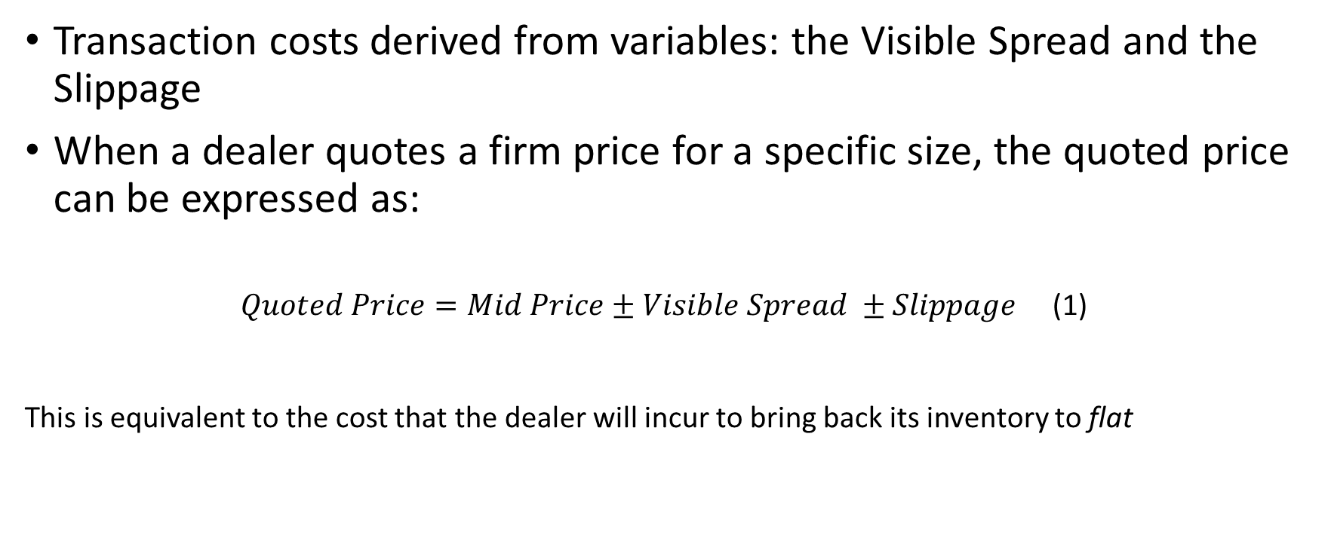
Transactional Costs
Transaction costs derived from variables: the Visible Spread and the Slippage
When a dealer quotes a firm price for a specific size, the quoted price can be expressed as:
$Quoted Price=Mid Price±Visible Spread ±Slippage$ (1)
This is equivalent to the cost that the dealer will incur to bring back its inventory to flat

Slide 5
Visible Costs
The Mid Price and visible B/O Spread are easily observable and constitue the visible costs
The visible B/O Spread is the difference between the inside or top-of-the-book Offer and Bid prices
The Mid Price is the average of the top-of-the-book Bid and Offer prices
Mid Price and B/O Spread are generic indicative price of a transaction BUT does not take into account the size of the transaction nor the liquidity available at the projected time of the transaction
The mid price plus visible spread is NOT a reasonnable approximation to the cost of a transaction

Slide 6
Hidden Cost -- Slippage
Slippage is the “premium” or the cost in excess to the visible costs that a dealer charges to manage the risk taken to fill the order given its size and the then market liquidity
Upon filling an order of size S, a dealer can to get back to flat either
Execute against the Standing Liquidity of the market then – she is hedging her position immediately
Execute against the Liquidity Flow – she is then waiting passively for subsequent orders to get her out of just acquired risk
Or some of each method, doing both approaches

Slide 7
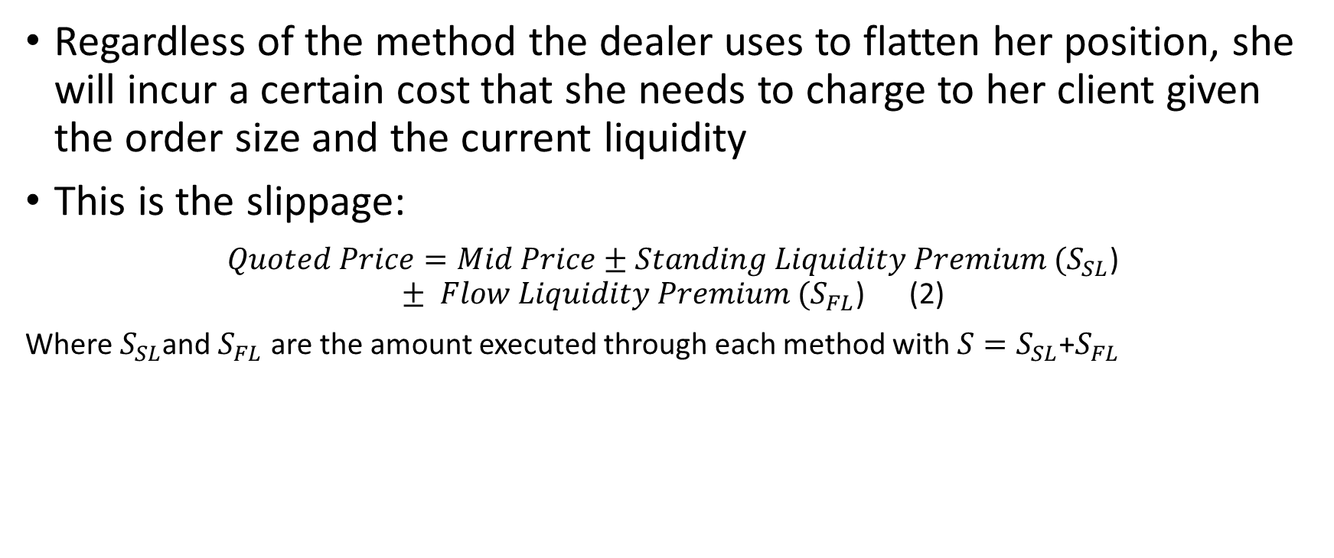
Liquidity and Flow Premia
Regardless of the method the dealer uses to flatten her position, she will incur a certain cost that she needs to charge to her client given the order size and the current liquidity
This is the slippage:
$Quoted Price=Mid Price±Standing Liquidity Premium (S_{SL}$) $± Flow Liquidity Premium (S_{FL}$) (2)
Where $S_{SL}$and $S_{FL}$ are the amount executed through each method with ${S=S}_{SL}$+$S_{FL}$

Slide 8
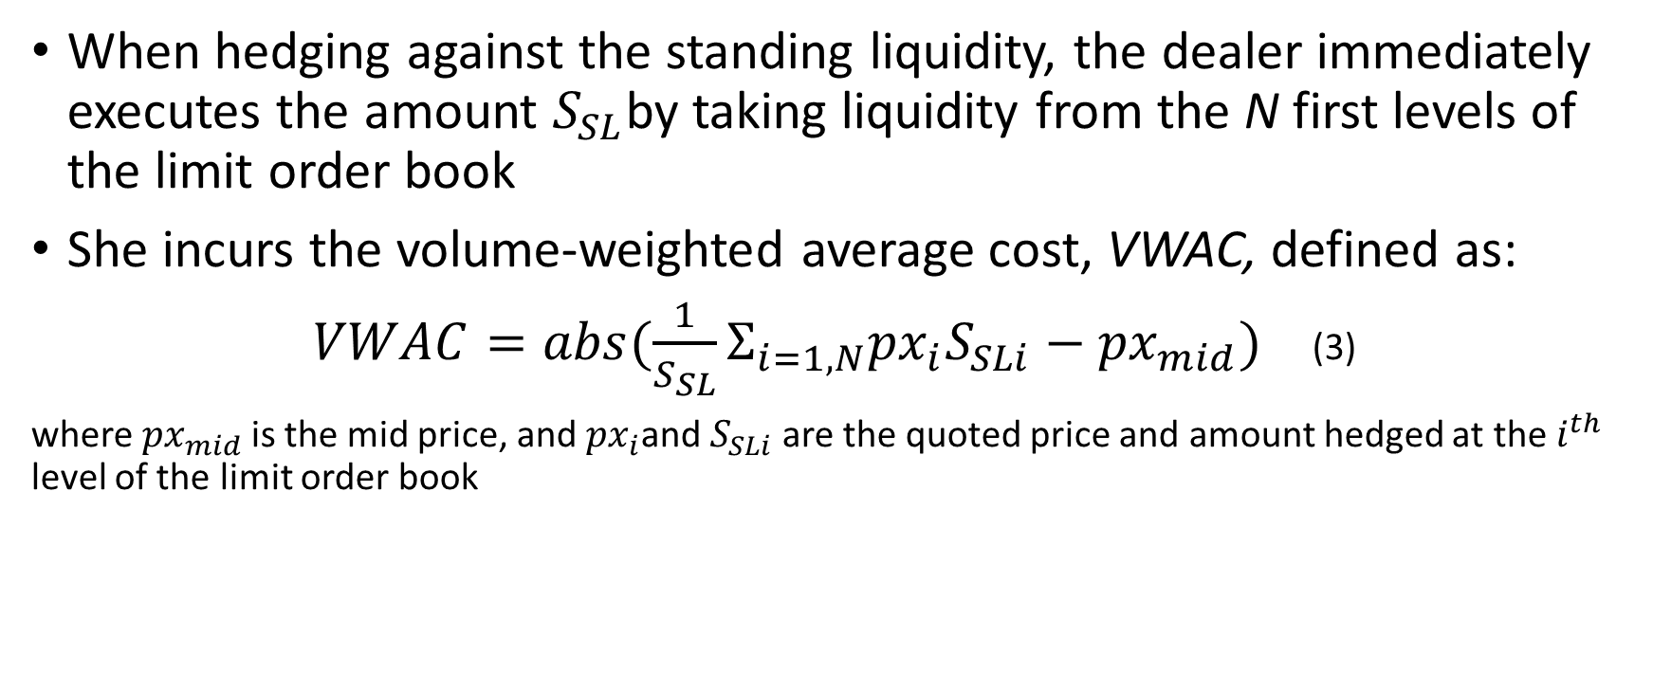
Standing Liquidity Premium
When hedging against the standing liquidity, the dealer immediately executes the amount $S_{SL}$by taking liquidity from the N first levels of the limit order book
She incurs the volume-weighted average cost, VWAC, defined as:
$VWAC=abs(\frac{1}{S_{SL}}Σ_{i=1,N}{px}_{i}S_{SLi}−{px}_{mid})$ (3)
where ${px}_{mid}$is the mid price, and ${px}_{i}$and $S_{SLi}$ are the quoted price and amount hedged at the $i^{th}$ level of the limit order book

Slide 9
LOB – Limit Order Book

Slide 10
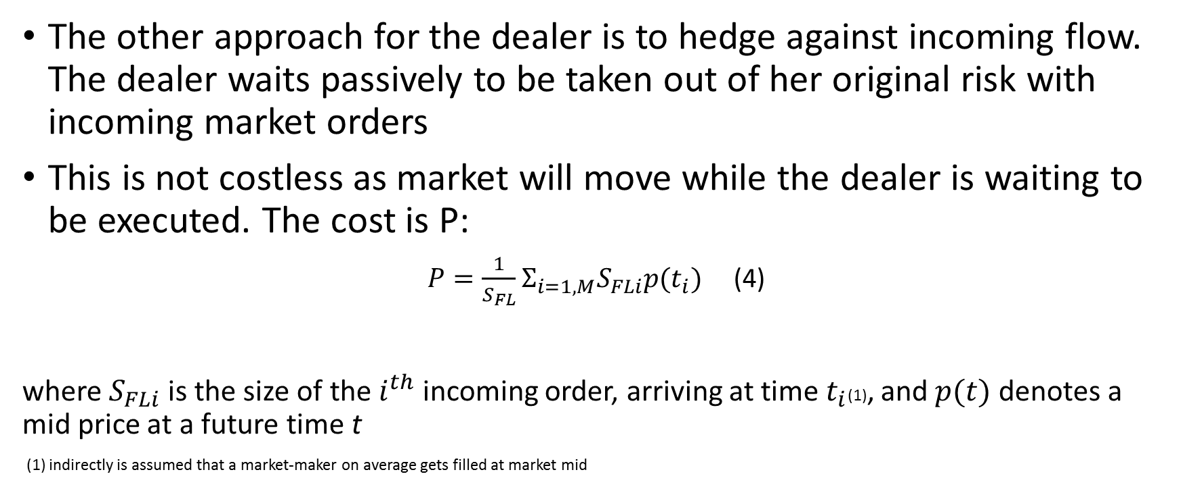
Flow Liquidity Premium
The other approach for the dealer is to hedge against incoming flow. The dealer waits passively to be taken out of her original risk with incoming market orders
This is not costless as market will move while the dealer is waiting to be executed. The cost is P:
$P=\frac{1}{S_{FL}}Σ_{i=1,M}S_{FLi}{p(t}_{i})$ (4)
where $S_{FLi}$ is the size of the $i^{th}$ incoming order, arriving at time${ t}_{i}$(1), and $p(t)$ denotes a mid price at a future time t
(1) indirectly is assumed that a market-maker on average gets filled at market mid

Slide 11
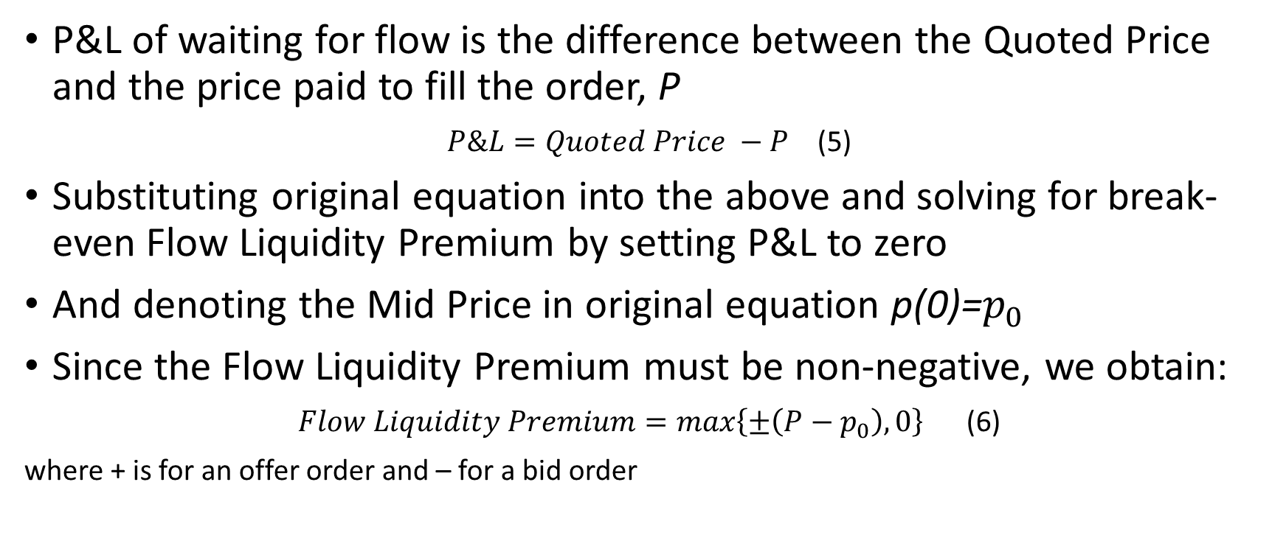
Flow Liquidity Premium...
P&L of waiting for flow is the difference between the Quoted Price and the price paid to fill the order, P
$P\&L=Quoted Price −P$ (5)
Substituting original equation into the above and solving for break-even Flow Liquidity Premium by setting P&L to zero
And denoting the Mid Price in original equation p(0)=$p_{0}$
Since the Flow Liquidity Premium must be non-negative, we obtain:
$Flow Liquidity Premium=max\left\{±\left(P−p_{0}\right),0\right\}$ (6)
where + is for an offer order and – for a bid order

Slide 12
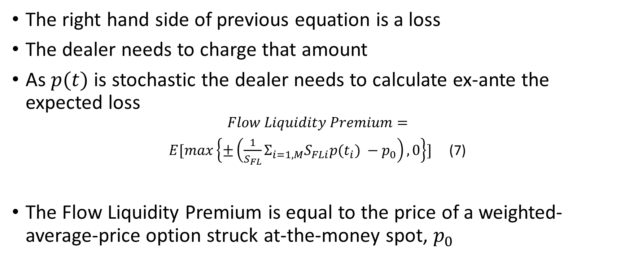
Flow Liquidity Premium
The right hand side of previous equation is a loss
The dealer needs to charge that amount
As $p(t)$ is stochastic the dealer needs to calculate ex-ante the expected loss
$$Flow Liquidity Premium=$$
$E[max\left\{±\left(\frac{1}{S_{FL}}Σ_{i=1,M}S_{FLi}{p(t}_{i}) −p_{0}\right),0\right\}]$ (7)
The Flow Liquidity Premium is equal to the price of a weighted-average-price option struck at-the-money spot, $p_{0}$

Slide 13
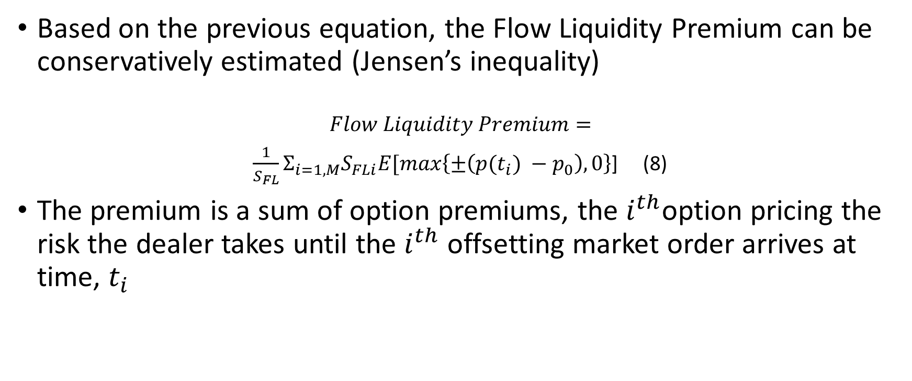
Flow Liquidity Premium
Based on the previous equation, the Flow Liquidity Premium can be conservatively estimated (Jensen’s inequality)
$$Flow Liquidity Premium=$$
$\frac{1}{S_{FL}}Σ_{i=1,M}S_{FLi}E[max\left\{±\left({p(t}_{i}) −p_{0}\right),0\right\}$] (8)
The premium is a sum of option premiums, the $i^{th}$option pricing the risk the dealer takes until the $i^{th}$ offsetting market order arrives at time, $t_{i}$

Slide 14
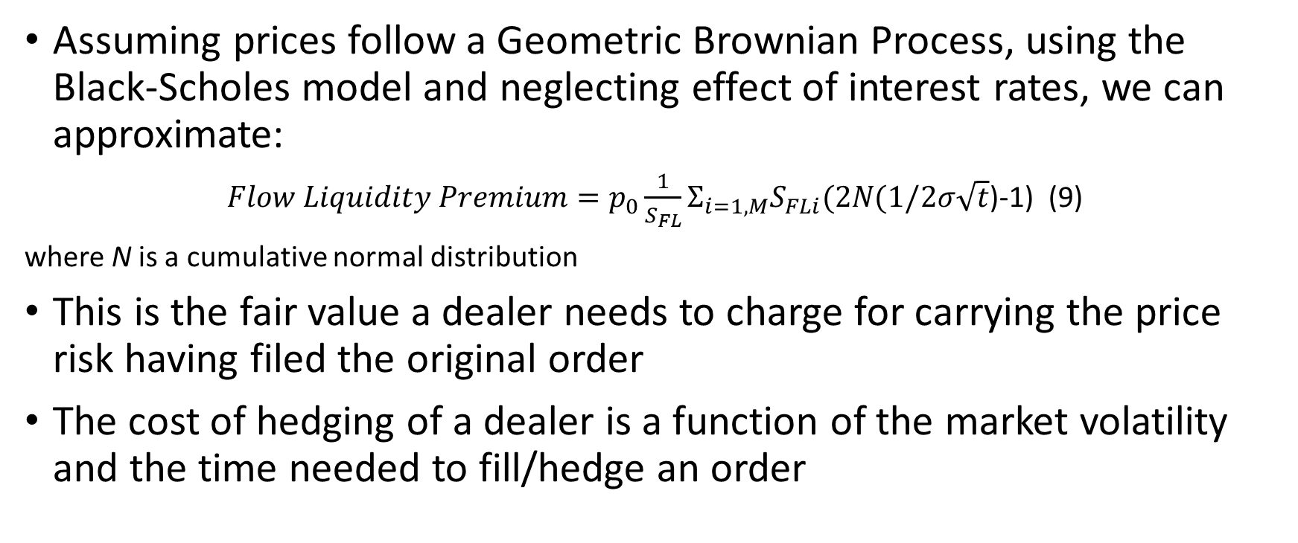
Flow Liquidity Premium
Assuming prices follow a Geometric Brownian Process, using the Black-Scholes model and neglecting effect of interest rates, we can approximate:
$Flow Liquidity Premium=p_{0}\frac{1}{S_{FL}}Σ_{i=1,M}S_{FLi}(2N(1/2σ\sqrt{t}$)-1) (9)
where N is a cumulative normal distribution
This is the fair value a dealer needs to charge for carrying the price risk having filed the original order
The cost of hedging of a dealer is a function of the market volatility and the time needed to fill/hedge an order

Slide 15
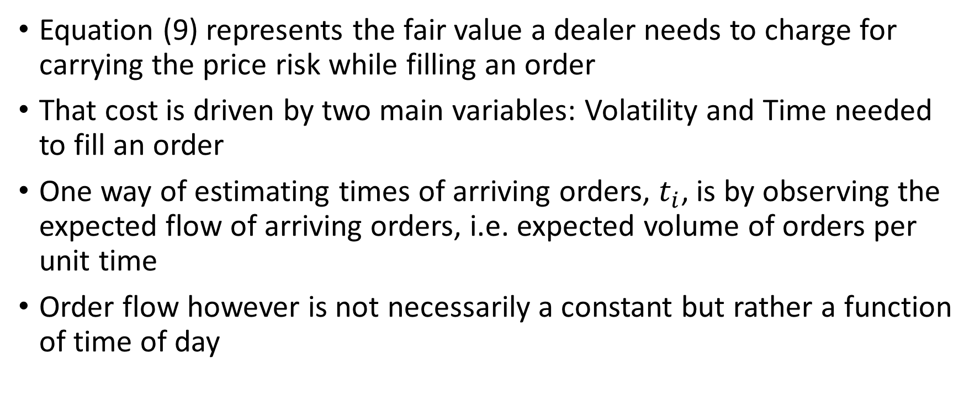
Flow Liquidity Premium ...
Equation (9) represents the fair value a dealer needs to charge for carrying the price risk while filling an order
That cost is driven by two main variables: Volatility and Time needed to fill an order
One way of estimating times of arriving orders, $t_{i}$, is by observing the expected flow of arriving orders, i.e. expected volume of orders per unit time
Order flow however is not necessarily a constant but rather a function of time of day

Slide 16
Daily Flow used to estimate Expected Arrival Time

Slide 17
Expected Cost based on intraday liquidity curves

Slide 18
Projected Cost

Slide 19
Last Look in FX
The OTC FX markets are of two types:
Markets with conventional resting orders
Markets with resting orders which include optionality (1)
(1) The optionality is owned by the market maker and provides the option to the market maker to refuse to fill the order of the market taker

Slide 20
Last Look in FX
The first type of markets are called Orders crossing Orders (OXO) markets
Takers orders matching Resting orders will be filled under most circumstances
In the second type of markets, the makers provided to takers thru a one-to-one API a continous stream of bid and offer prices.
The taker then places a request to the streaming maker to be done at mots current bid or offer shown
The maker then decides whether to fill, to partially fill or to reject the request to trade from the taker

Slide 21
Last Look in FX – the Why?
This process is referred as Last Look (LL)
The maker of the resting order is given an option on whether to honor the traker’s request to trade on the maker’s own shown resting order
This unusual pratice arose from the need for themaker to protect herself from Latency Arbitrage by the takers as electronic trading in FX took root

Slide 22
Last Look in FX – how much is it worth?
Like for any other option, its value is a function of the time to expiry and the volatility of the underlying
The longer the time to expiry the more valuable is the LL feature
LL duration can vary from 50 to 500 milliseconds, typically
The higher the volatility of the markets then the more valuable the LL feature
note that you should estimate the Bid volatility and the Offer volatility for a short time window of the order of the typical LL duration

Slide 23
Last Look in FX – this is a competitive market
Makers are getting valuable optionality
Makers compete for these LL orders and therefore give back some of their option-based gain to the takers through tigher B/O spreads
The makers furthermore reduce their gains by committing to their takers clients a high ninimum fill rate
I personally demand no less than 95% fill ratio
Finally, the takers demand to have their orders filled or killed within a limited time which is getting shorter.
I personally demand a response within at most 100 milliseconds

Slide 24
Last Look in FX – an interesting behavior

